Slide 1
Classification
By Francisco Mendoza
mentofran@gmail.com

Slide 2
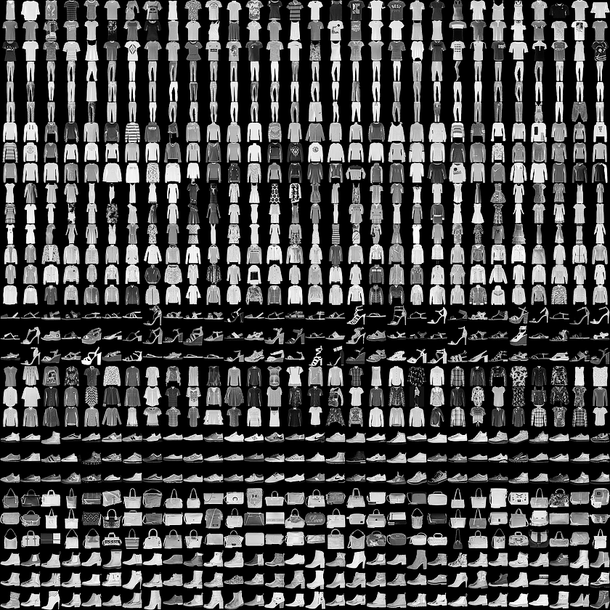
Image classification Fashion MNIST dataset
Notes:
https://www.tensorflow.org/tutorials/keras/classification

Slide 3
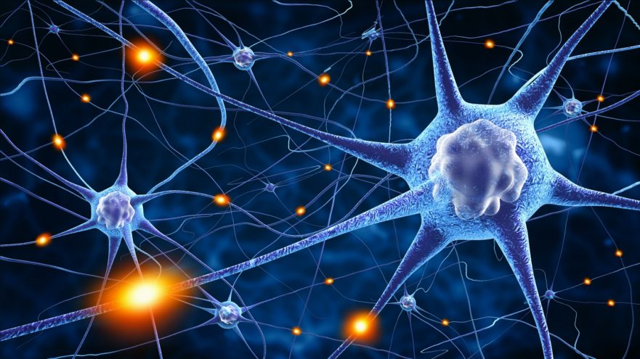
Artificial Neural Networks (ANN)

Slide 4
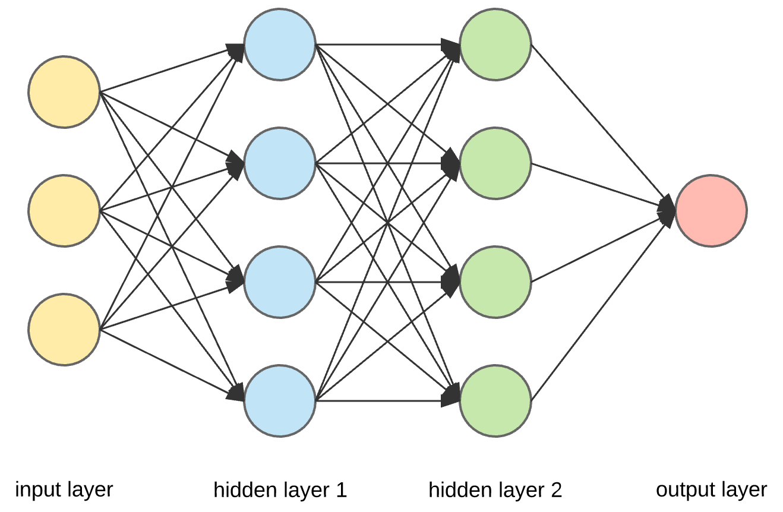
Deep learning
Fully connected ANN
Neurons, nodes, units

Slide 5
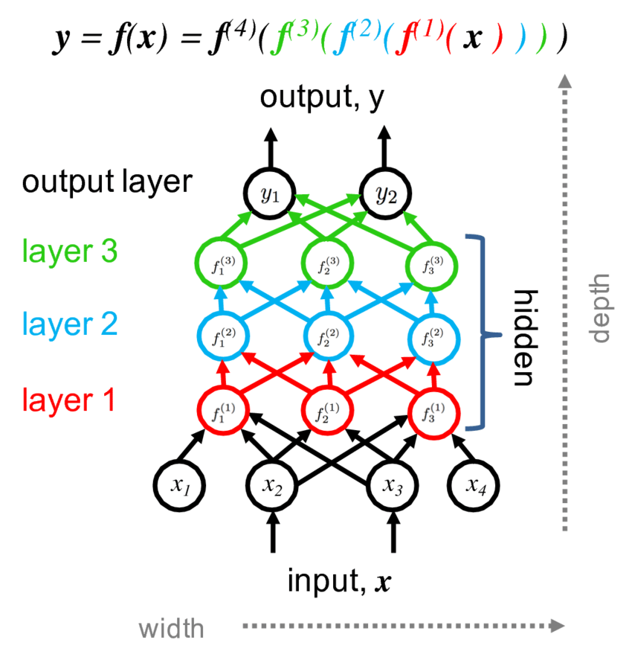

Slide 6
https://medium.com/onfido-tech/machine-learning-101-be2e0a86c96a

Slide 7
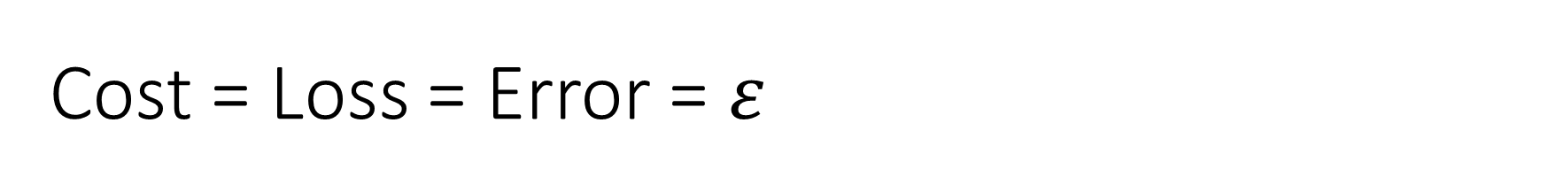
Cost = Loss = Error = $ε$
https://medium.com/onfido-tech/machine-learning-101-be2e0a86c96a
Notes:
https://www.tensorflow.org/tutorials/keras/classification
https://towardsdatascience.com/epoch-vs-iterations-vs-batch-size-4dfb9c7ce9c9
https://medium.com/onfido-tech/machine-learning-101-be2e0a86c96a
https://mlfromscratch.com/optimizers-explained/#/

Slide 8
Optimizers
SGD
Adam

Slide 9
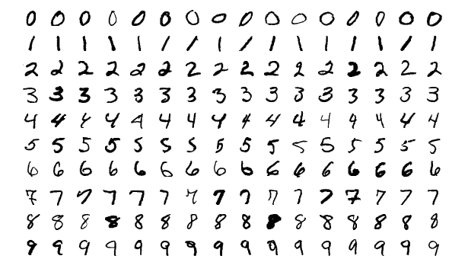
Homework assigment
(x_train, y_train), (x_test, y_test) = tf.keras.datasets.mnist.load_data()
https://upload.wikimedia.org/wikipedia/commons/2/27/MnistExamples.png
Notes:
https://www.tensorflow.org/tutorials/quickstart/beginner

Slide 10
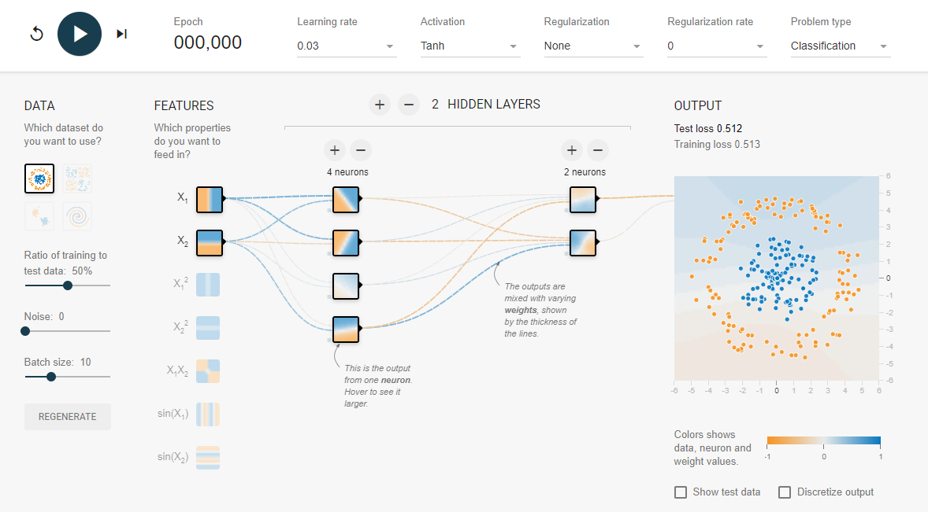
https://playground.tensorflow.org/

Slide 11
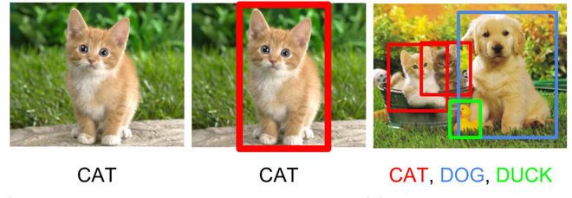
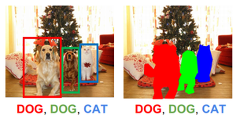
Going further in computer vision
Classification
+ Localization
Classification
Object detection
Instance
Segmentation
Color segmentation
https://www.geeksforgeeks.org/object-detection-vs-object-recognition-vs-image-segmentation/

